Slide 1

Education Explorer Recommendation System
Using k- mean Clustering Algorithm
By:
Biswas Shrestha (3270/070)
Smaran Maharjan (3283/070)
Samit Shakya (3284/070)
Sanjay Pokhrel (3285/070)

Slide 2
Contents
Introduction
Problem Statement
System Objective
Methodology
Requirement Specification
High Level Design
Implementation Algorithm
Tools and technology used
Project Schedule
Expected Outcome
References

Slide 3
Introduction
Education Explorer is a recommendation engine that finds the right college for the users(student)
Uses recommendation algorithm(by category) and data mining techniques(K mean clustering)
Helps for choosing the right from hundreds of colleges and universities according to their major subjects, programs, scholarships.
Finds the right college according to location, fee and affiliation.
Provide notification about upcoming educational, technical events happening around Kathmandu valley on android device.

Slide 4
Problem Definition
It is difficult to find and visit each and every college in busy cities like Kathmandu
Student can’t get enough information or proper enrollment according to requirement
Student are even found to be in dilemma to get best course for their future or the best institute for them to enroll

Slide 5
Objective
To provide recommending according to the selected course by the category.
To provide detail information about course including trending course.
To find information about financial aid statistics such as average amount, percent of student received, total amount received for university of your choice.
To save time and effort, you can compare schools of your choice and find best that fits your criteria.

Slide 6
Study of Existing system
application name “Education Finder College Search”
mainly focusing the students of United States, France and other European countries
find and choose from more than 25 thousand colleges from following features:
Scholarships/bursaries/fellowships
Financial aid & stats
Check out reviews & find alumni’s.
Stay tuned & get involved in schools with get social
Compare schools
Track university application & get notifications
Visa information
News feeds

Slide 7
Requirement Specification
Input
Searching
Recommendation
Output
Feedback

Slide 8
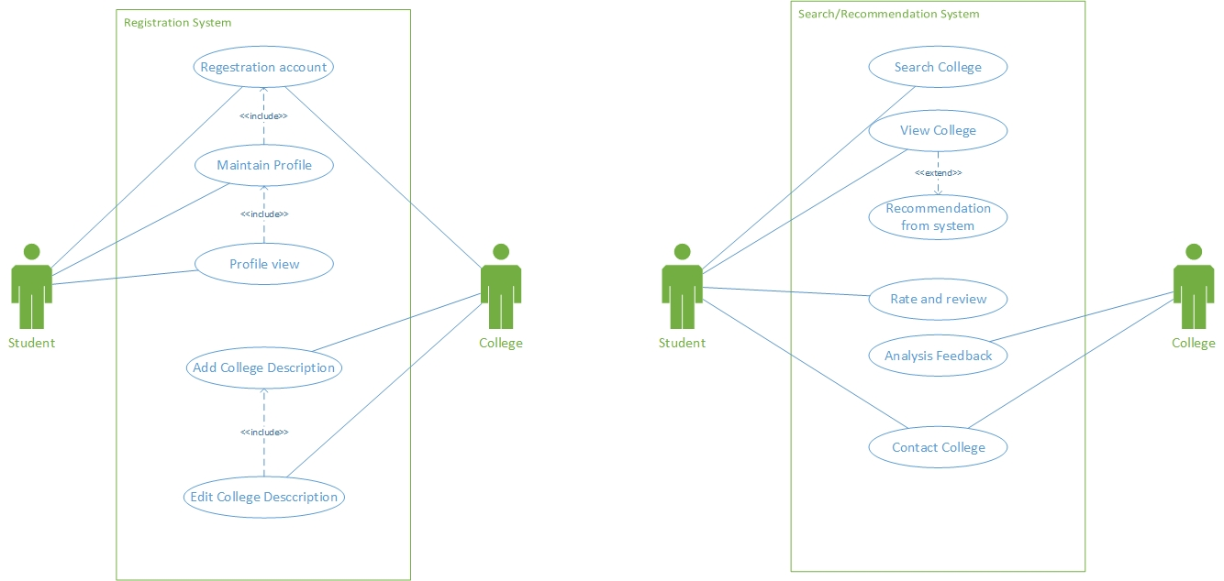
Use Case diagram
Fig: Use Case Diagram of Education Explorer

Slide 9
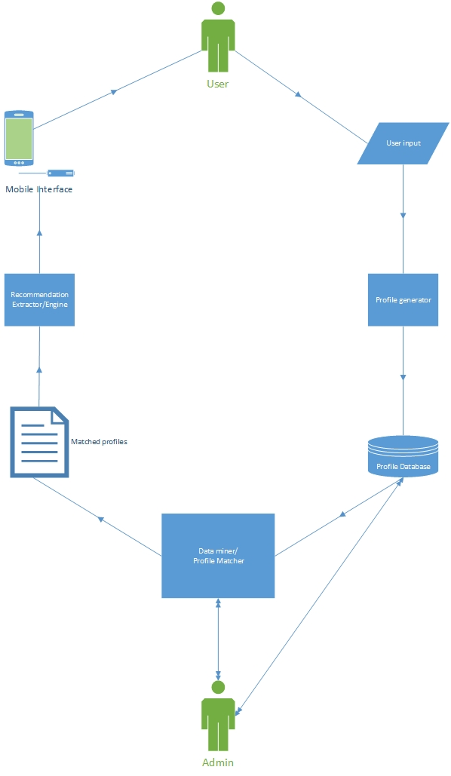
System Diagram
Fig: System Flow Chart of Education Explorer

Slide 10

K-mean Clustering
Let X = {x₁,x₂,x₃,……..,x_{n}} be the set of data points and V = {v₁,v₂,…….,v_{c}} be the set of centers.
Randomly select ‘c’ cluster centers.
Calculate the distance between each data point and cluster centers.
Assign the data point to the cluster center whose distance from the cluster center is minimum of all the cluster centers.
Recalculate the new cluster center using:
where, ‘c_{i}’ represents the number of data points in i^{th} cluster.
Recalculate the distance between each data point and new obtained cluster centers.
If no data point was reassigned then stop, otherwise repeat from step 3).

Slide 11
Tools & Technology Used
Front End: Android Studio
Back End: DBMS(MySQL) , Python, AzureML

Slide 12
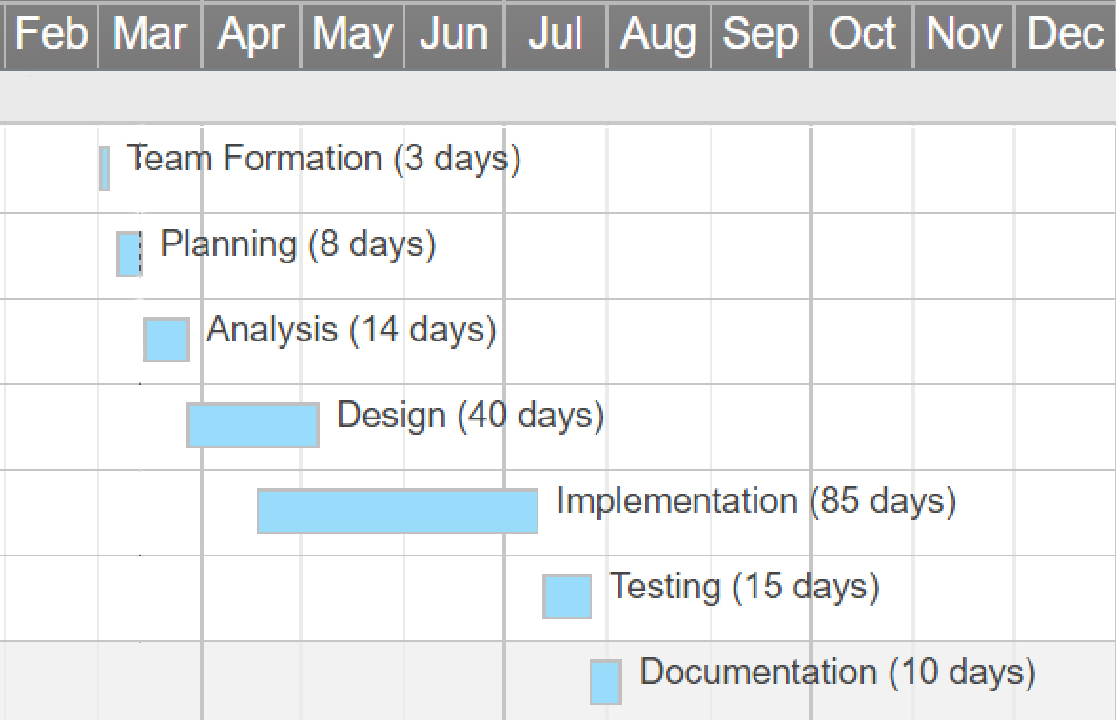
Project schedule
Fig: Gantt chart for project scheduling

Slide 13
Expected Outcome
Effective Recommendation
User friendly GUI based Output
Save the time and effort of countless students and parents.

Slide 14
References
Baker, H. Kent, and Powell, Gary E., Understanding Financial Management: A Practical Guide. Blackwell Publishing.
Chen, M.T., (1996), “ Simplified project economic evaluation.” Transactions of AACE International. ABI/INFORM Global.
Cohan, P.S., (2005), “CFOs to Tech: ‘I’ll Spend For The Right Technology’.” Financial Executive Apr 2005. ABI/INFORM Global.
Demirhan, D., Jacob, V.S., and Raghunathan, S., (2006), “Information Technology Investment Strategies Under Declining Technology Cost.” Journal of Management Information Systems. Vol. 22 No. 3, Winter 2006. pp. 321 – 350
Willbanks., Linda (2007), "Passing out IT Toys." CIO Corner, IT Pro. November/December 2007.
https://developer.android.com/index.html
https://www.ed-finder.com/
https://www.python.org/
https://www.w3schools.com/
http://www.saedsayad.com/clustering_kmeans.htm

Slide 15

Queries

Slide 16
Thank You!!!
“Education Explorer” is one-stop-shop for “Inspiring students to make an informed choice”

